Slide 1
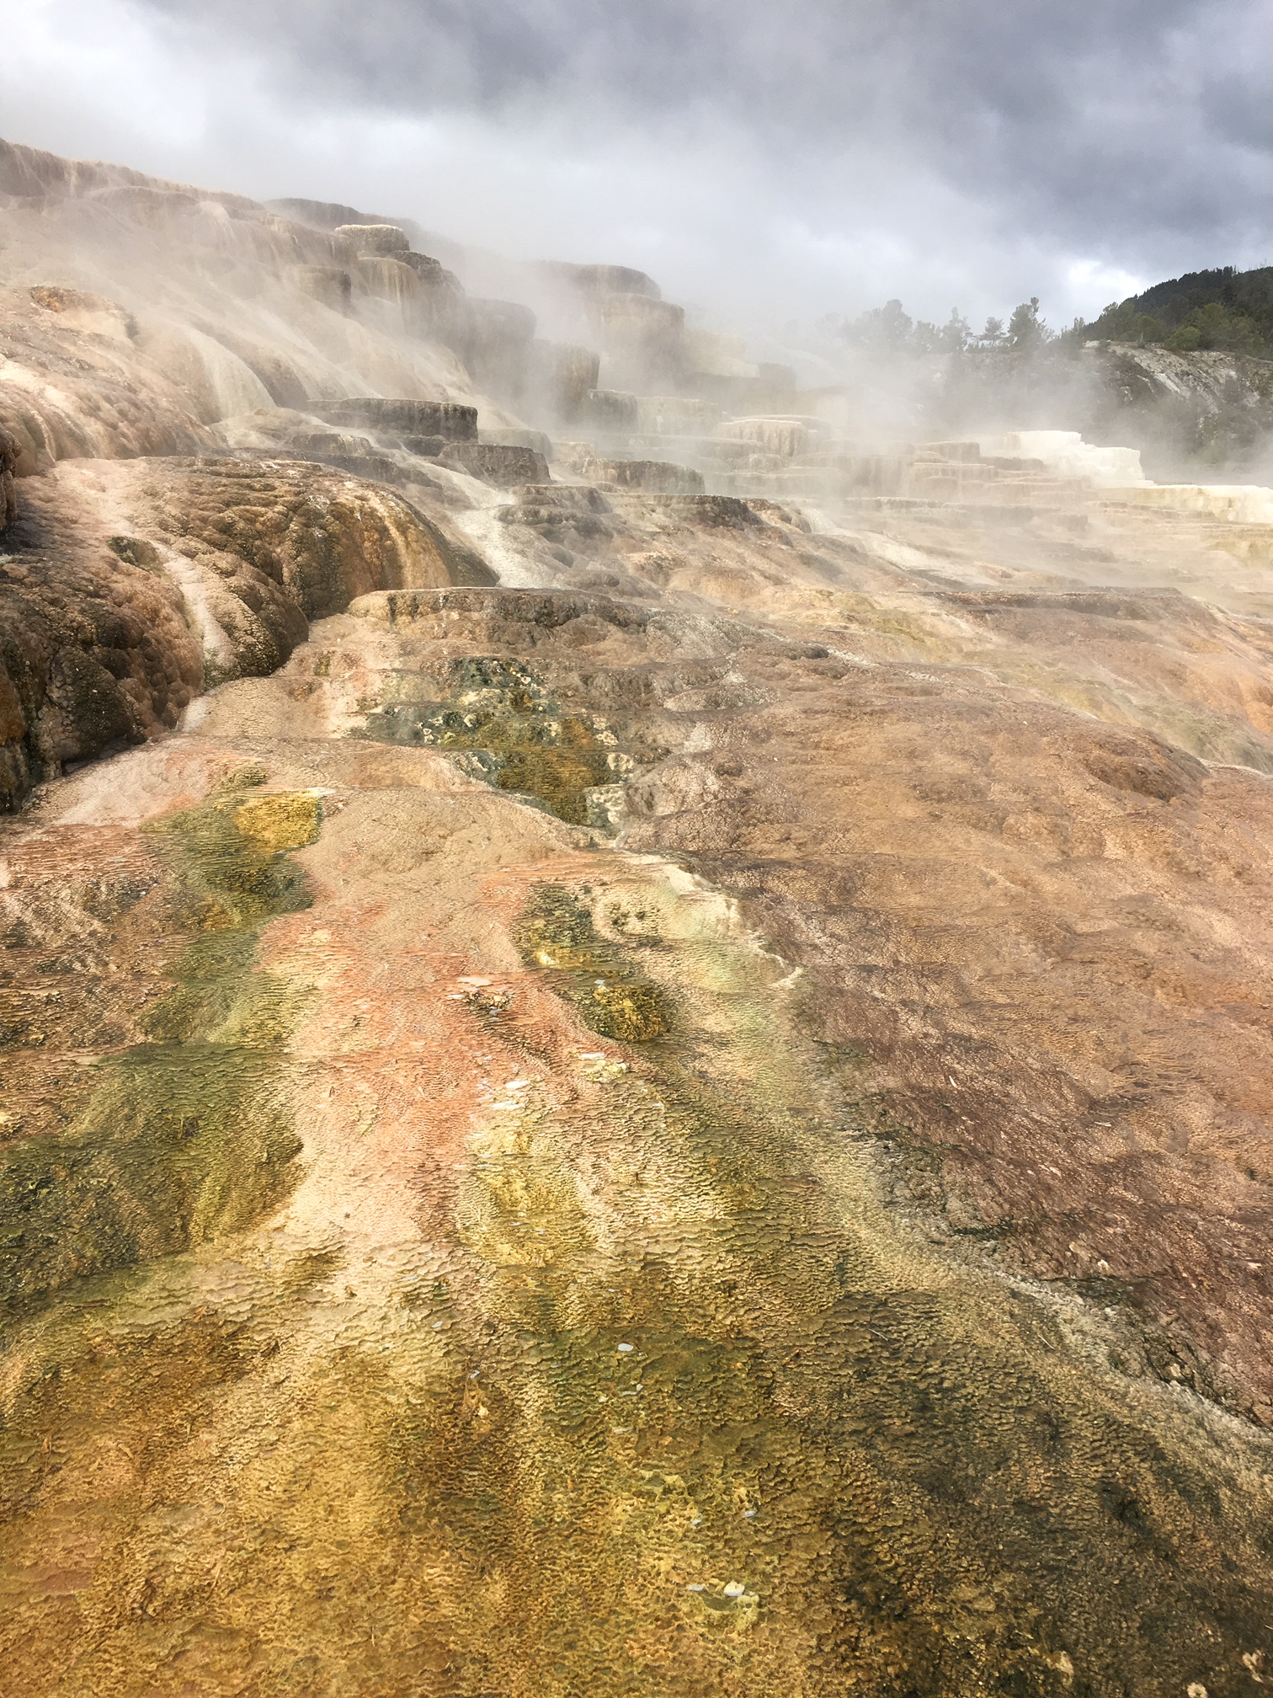
Demonstrating Visibility Progress using Monitoring and Modeling Data
Example: Yellowstone National Park
Coordination and Glidepath Subcommittee Call
December 12, 2019
Yellowstone Mammoth Hot Springs

Slide 2
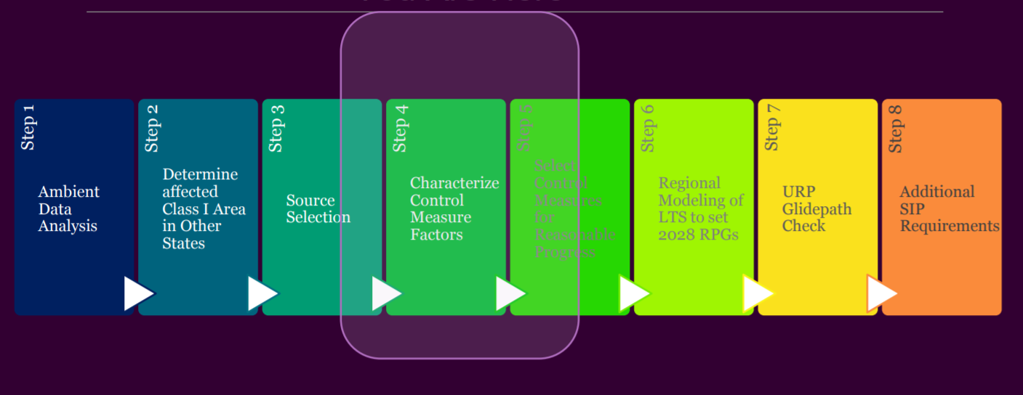
WRAP Technical Support System Regional Haze Delivery
Coord + Glidepath
RTO/Control Measures
States
RTO/Em+ Protocol
RTO/Coord + Glidepath
WRAP
Steps follow RHR and EPA Guidance
2014 Q/d,
2028 WEP
Ramboll
CIRA, ARS
Ramboll
CIRA
Review, Coordination, Consultation
Coordination + Glidepath

Slide 3
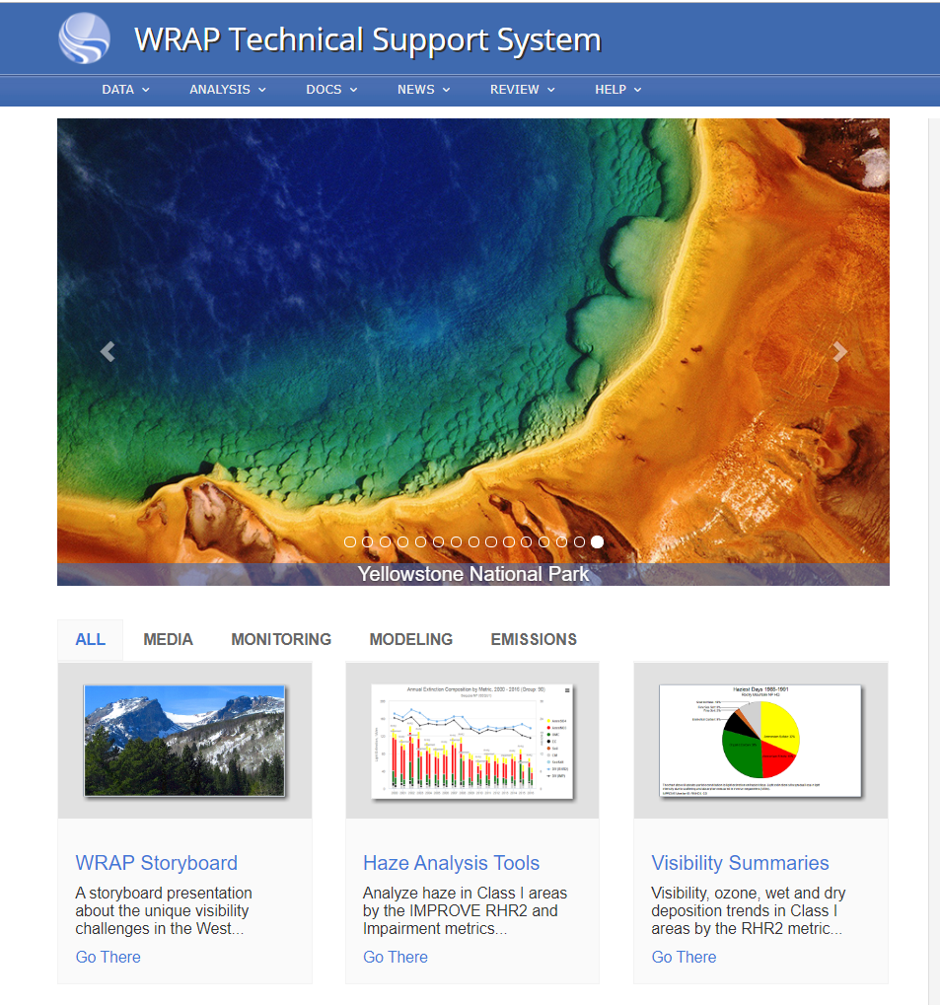

Proposed Revised TSS layout
Haze SIP Planning Tools
Key Class I area analyses supporting Regional Haze SIP Planning
Go There

Slide 4
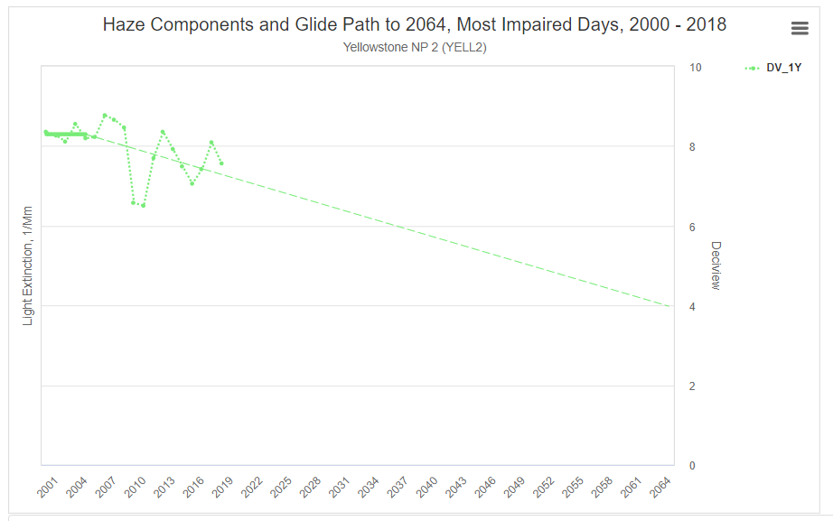
Technical Support System: Step 1 Ambient Data Analysis
http://views.cira.colostate.edu/tssv2/HazeAnalysis
IMPROVE Monitoring Data compared to
Regional Haze Glide Path for most impaired days
10
2000-2004 5 yr ave
8.3
Yellowstone National Park
7.5
2014-2018 5 yr ave
8
C
2064 EPA Natural Conditions
Deciview, dv*
EPA Uniform Rate of Progress
6
4.0
4
C
2
0

Slide 5
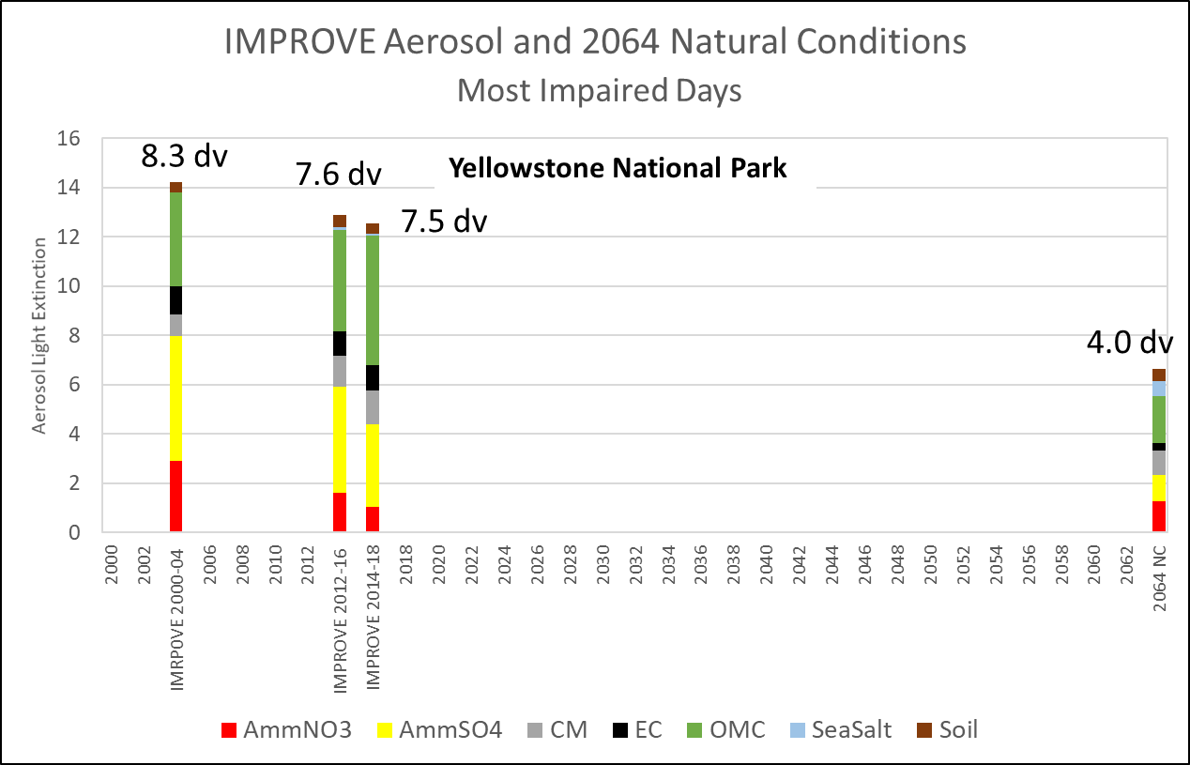

Demonstrating Visibility Progress using IMPROVE Aerosol Data –
Yellowstone National Park
IMPROVE + Uniform Rate of Progress Glide Path for most impaired days
10
2000-2004 5 yr ave
8.3
8
7.5
2014-2018 5 yr ave
C
2064 EPA Natural Conditions
Deciview, dv
6
EPA Uniform Rate of Progress
4.0
4
C
2
0
Deciview metric defines visibility trend.
Aerosol light extinction indicates pollutant
importance.

Slide 6
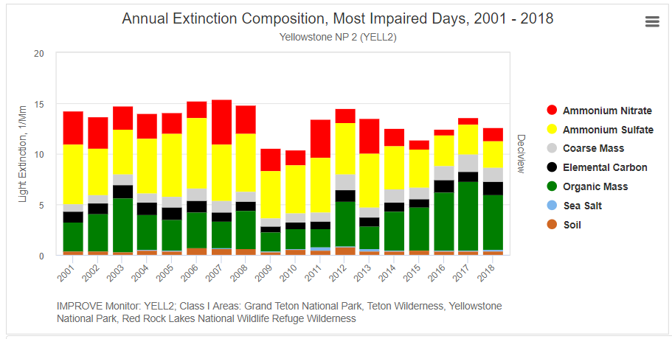
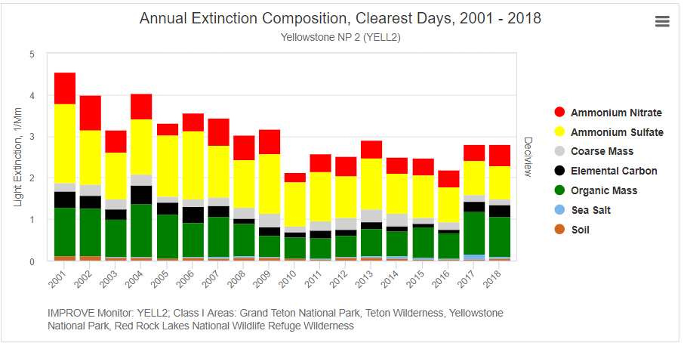
Demonstrating Visibility Progress with IMPROVE Aerosol Data –
Yellowstone National Park
Most Impaired days (defined using IMPROVE data and EPA methods)
Clearest days (defined using IMPROVE and EPA methods)
Reset vertical axis so same scale as MID

Slide 7
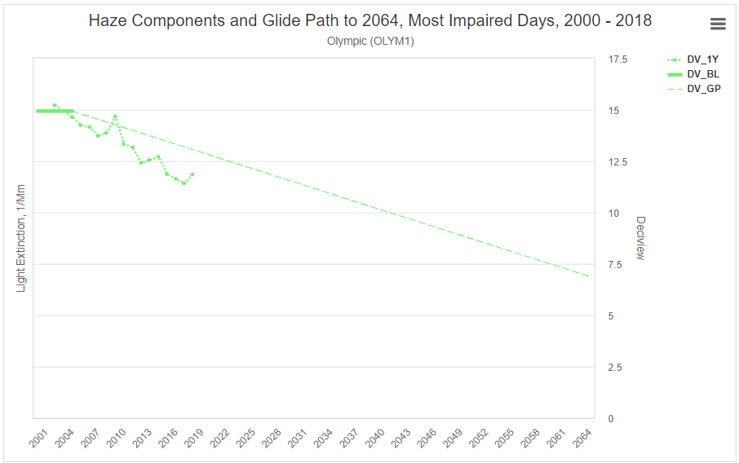
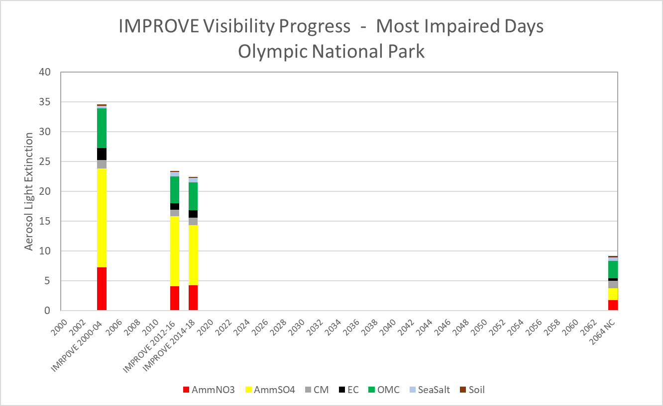
Demonstrating Visibility Progress with IMPROVE Aerosol Data - Olympic National Park
2000-2004 5 yr ave
15
14.9
2014-2018 5 yr ave
11.9
C
2064 EPA Natural Conditions
10
EPA Uniform Rate of Progress
Deciview, dv
6.9
C
5
14.9 dv
0
12.2 dv
11.9 dv
6.9 dv

Slide 8
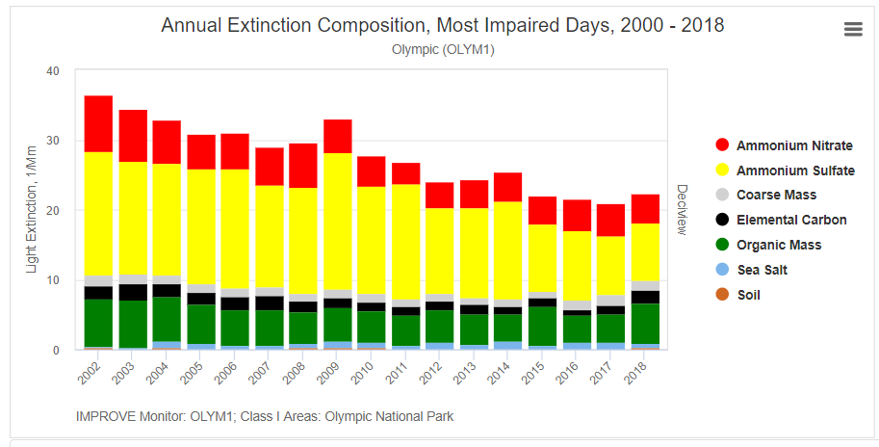
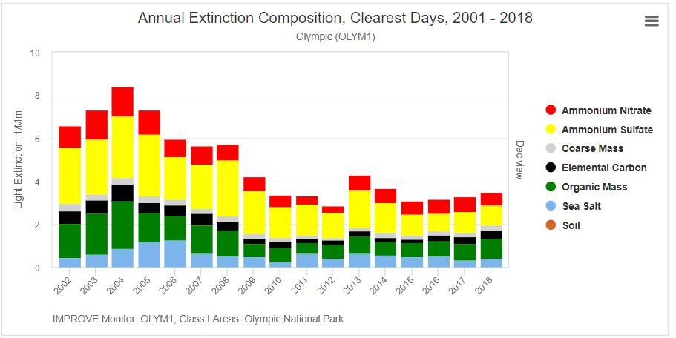
Demonstrating Visibility Progress with IMPROVE Aerosol Data - Olympic National Park
Most Impaired days (defined using IMPROVE data and EPA methods)
Clearest days (defined using IMPROVE and EPA methods)

Slide 9
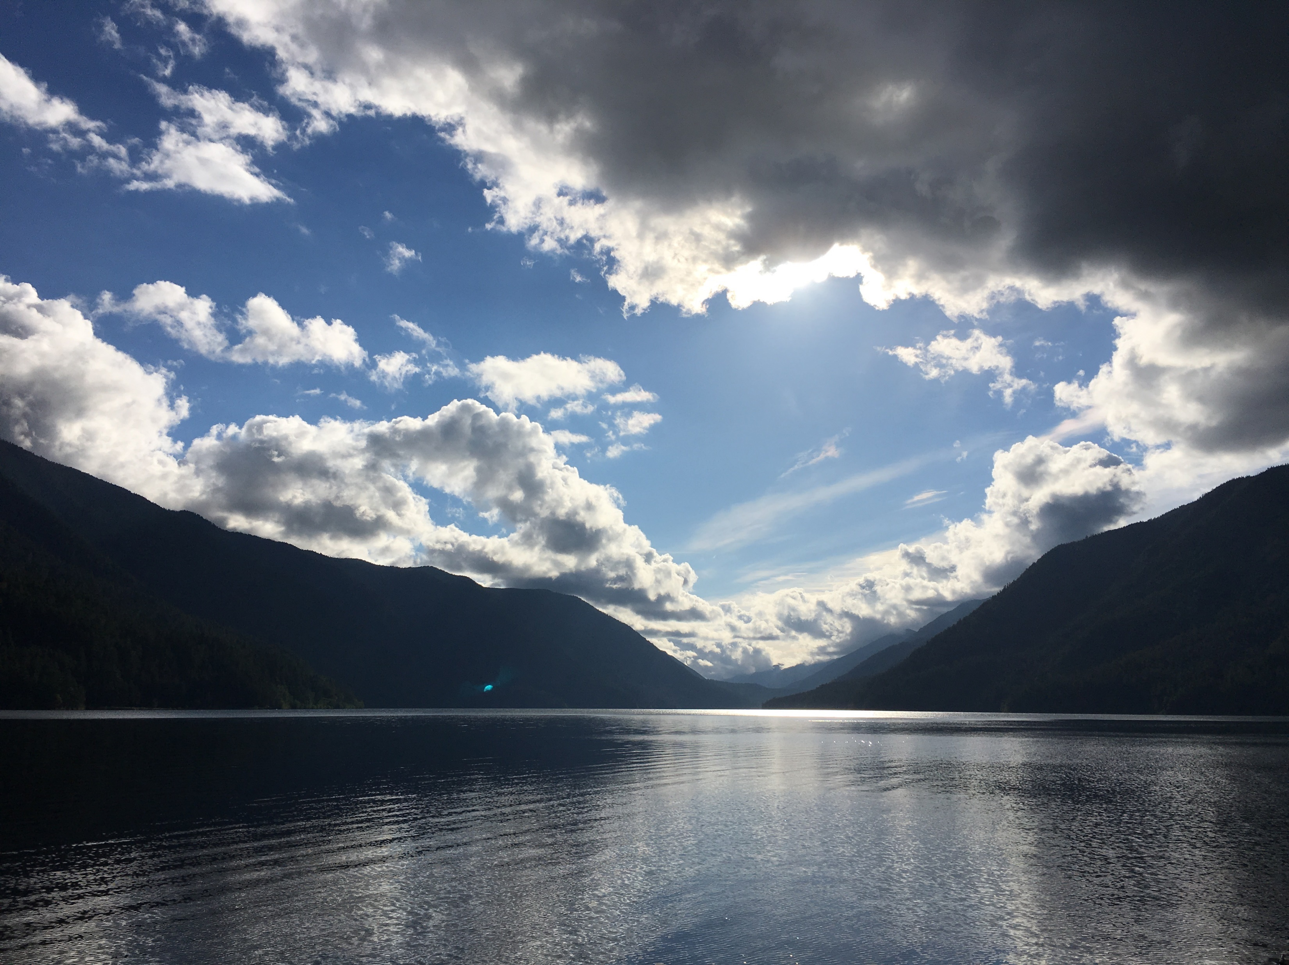
Lake Crescent, Olympic National Park

Slide 10
TSS: Step 2 Emissions: SO2, NOx, NH3, PM2.5, PM10, VOC
U.S. Emissions | Source Sector | Source Category | 2014v2 Actual fires | Baseline Rep fires | 2028 OTB w 2014v2 fires | 2028 OTB w Rep fires | 2028 0TB + Wild/Rx fire
Anthropogenic: U.S./WRAP/state | Point | EGU Point
 |  | NonEGU Point
 |  | OilGas Point
 | Area | OilGas Area
 |  | Industr Nonpoint
 |  | Agriculture
 |  | Prescribed fire
 |  | Agric fire
 |  | Residential Wood
 | Mobile On-Road | Highway vehicles
 | Mobile Non-Road | Airports, Rail, Marine, engines
Natural: U.S./WRAP/state | Natural | Wildfire
 |  | Biogenic, Geogenic, Ocean
2028 OTB +
Adopted Controls included in Workplan

Slide 11
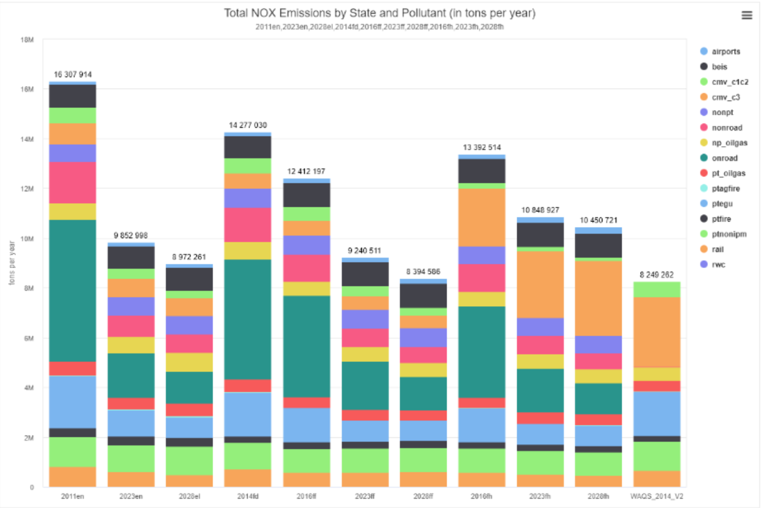
Emissions Example: Inventory Assembly on Intermountain West Data Warehouse
Query by U.S, WRAP, State, County
Incomplete

Slide 12
TSS: Step 6 Modeling Long Term Strategy: Weight of Evidence
Scenario
A2) 2014v2
B) Rep Baseline
2028 Scenario
C1) 2028 OTBw 2014v2fires
C2) 2028 OTBw Rep fires
D1) 2028 OTB Source Attribution
D2) 2028 + wildfire
D3) 2028 + Rxfire
C3/C4) 2028 + controls

Slide 13
TSS: Step 6 Modeling Long Term Strategy
2014v2 Model Performance Evaluation
Hypothetical Model Values

Slide 14
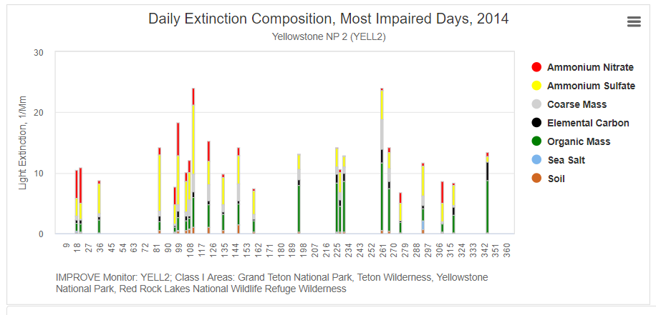
TSS: Step 6 Modeling Long Term Strategy
Model Performance Evaluation for each species: daily, all MID, ave all MID (insert CAMx next to IMPROVE for each MID)
And
Or ?

Slide 15
TSS: Step 6 Modeling Long Term Strategy
Comparing Model A2) 2014v2 to B) Baseline, Raw data

Slide 16
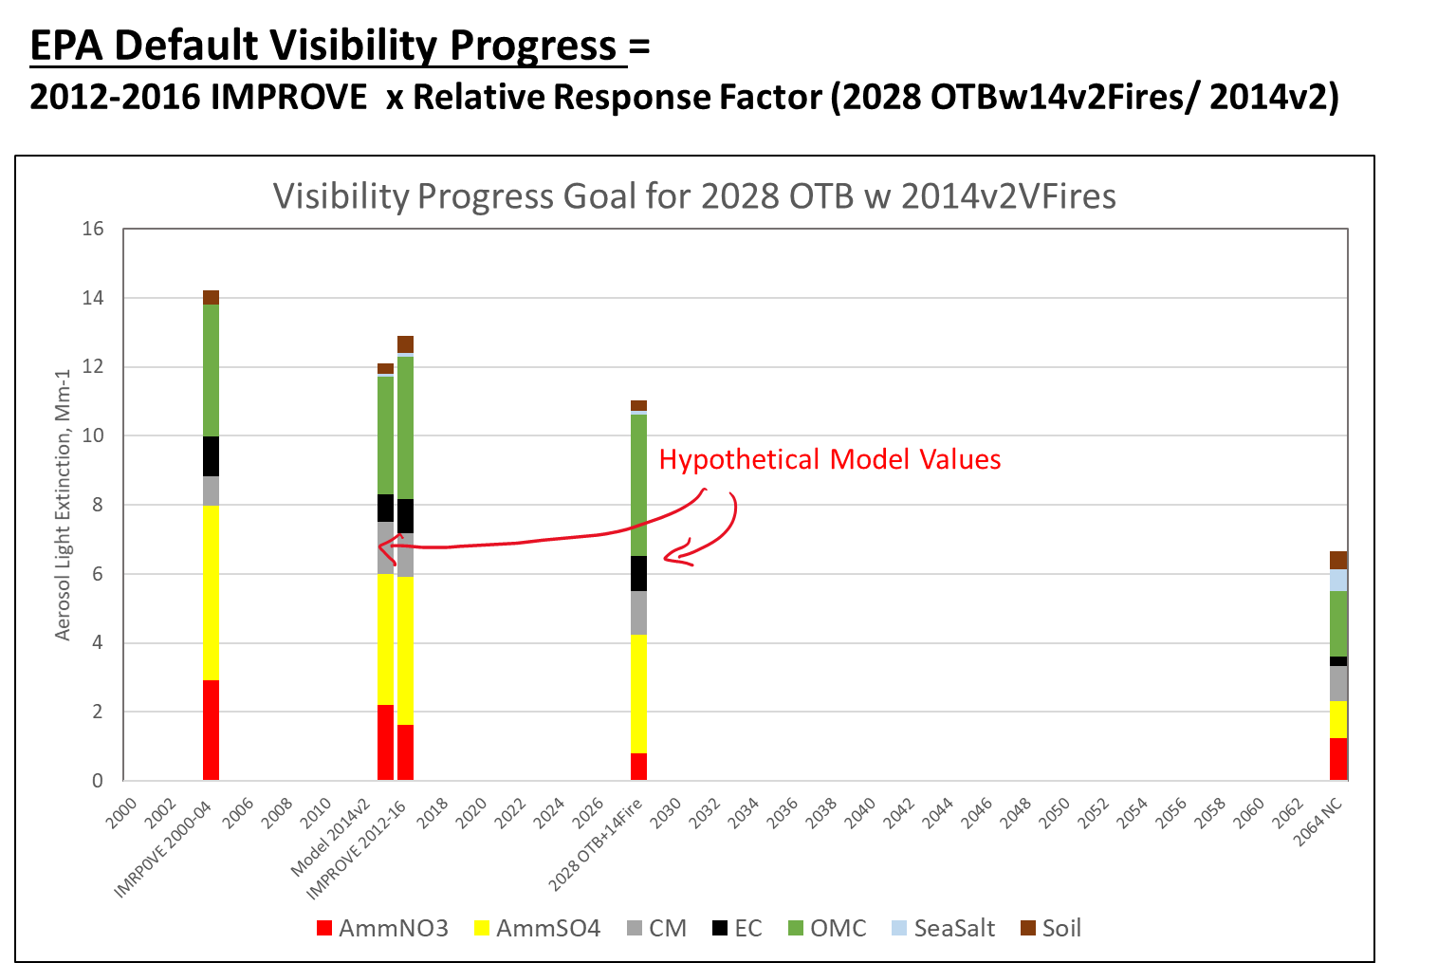
TSS: Step 7 Demonstrating Visibility Progress compared to Glidepath
Scenario
A2) 2014v2
2028 Scenario
C1) OTBw 2014v2fires
Relative Response Factor
C1 / A2
Visibility Progress
(C1 / A2) x 2012-16 IMPROVE

Slide 17
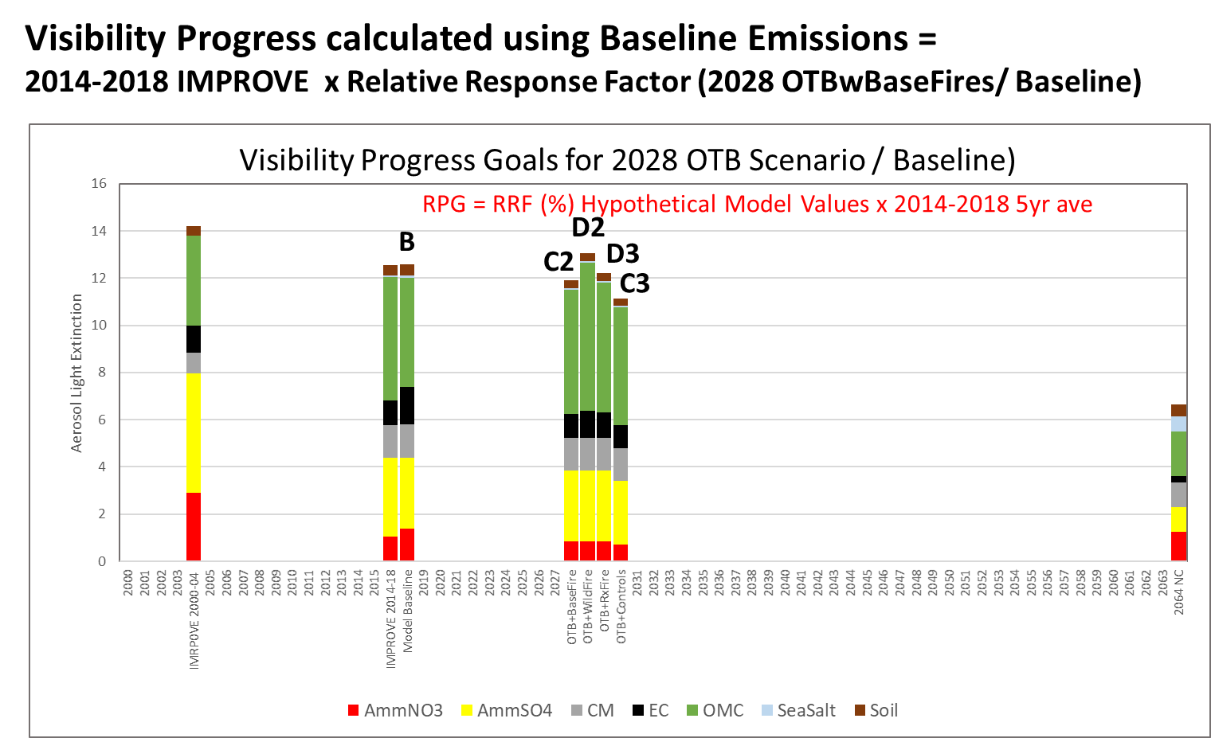
TSS: Step 7 Demonstrating Visibility Progress compared to Glidepath:
Scenario
B) Baseline
2028 Scenario
C2) OTBw Repfires
D2) C2+Wildfire
D3) C2+Rxfire
C3) C2+Controls
RRF x 2014-2018 IMPROVE
C2/B
D2/B
D3/B
C3/B

Slide 18
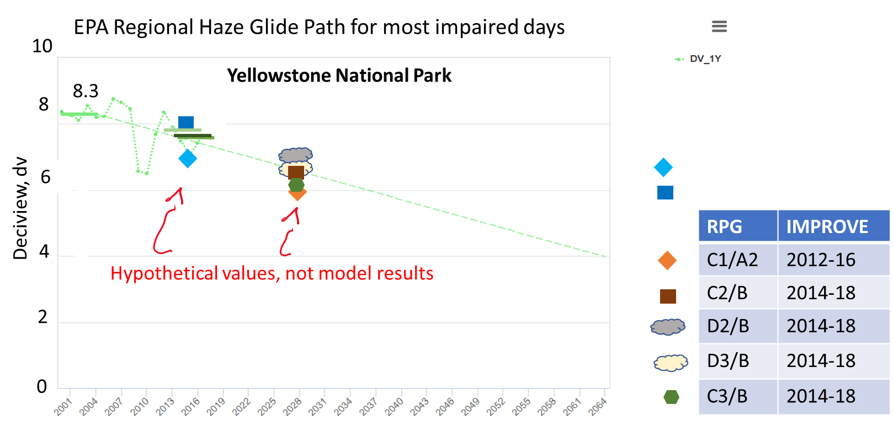
TSS: Step 7 Demonstrating Visibility Progress compared to Glidepath:
IMPROVE monitoring
2000-2004 5 yr ave
2012-2016 5 yr ave
2014-2018 5 yr ave
EPA Uniform Rate of Progress
A2) 2014 v2 Actual
B) Baseline

Slide 19
TSS: Defining U.S. Anthropogenic Contributions
at a Class I area – Dynamic Evaluation as Weight of Evidence
Objective: Define rate of Visibility Progress in response to change in U. S. Anthropogenic Emissions
Baseline Source Contributions | Baseline Methods: All Pollutants | Dynamic Model: 2002 | Dynamic Model: 2028
U.S./WRAP/state Anthropogenic | CAMx-PSAT CAMx-Zero Out | 2002 U.S. Anthropogenic | 2028 U.S. Anthropogenic
U.S./WRAP/state Natural | CAMx-PSAT CAMx-Zero Out | Baseline Natural | Baseline Natural
International Anthro | GEOS-Chem | Baseline International | Baseline International
International Natural

Slide 20

TSS: Defining U.S, Anthropogenic Contributions
at a Class I area – Dynamic Evaluation as Weight of Evidence
Yellowstone National Park

Slide 21
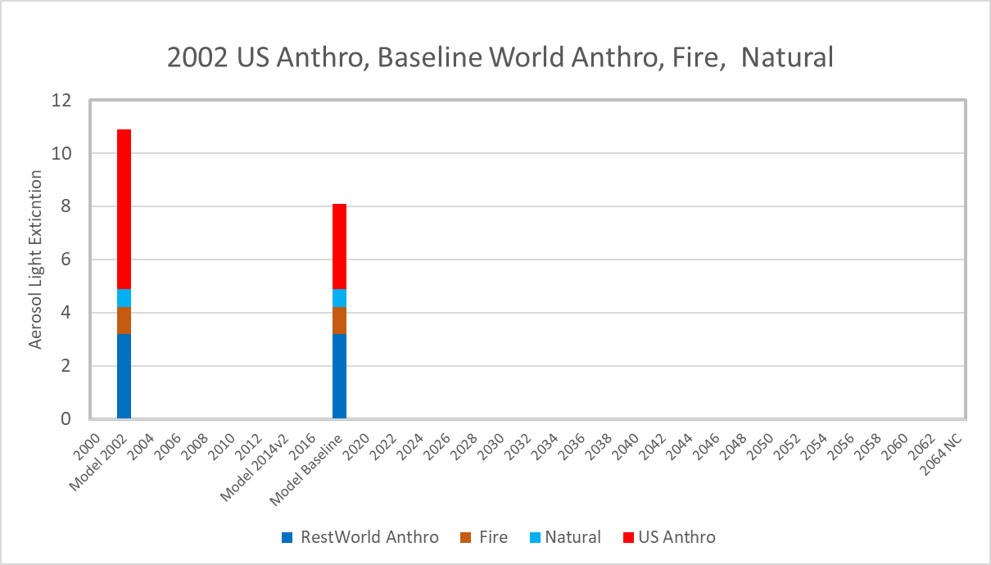
TSS: Defining U.S, Anthropogenic Contributions
at a Class I area – Dynamic Evaluation as Weight of Evidence

Slide 22
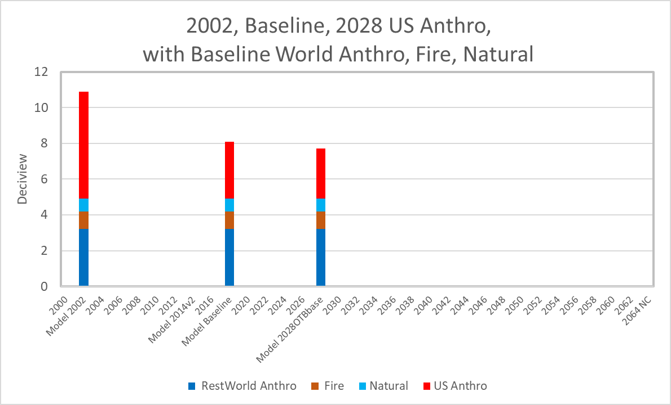
TSS: Defining U.S, Anthropogenic Contributions
at a Class I area – Dynamic Evaluation as Weight of Evidence

Slide 23
TSS: Defining 2028 Source Contributions at a Class I area using Particulate Source Apportionment Tool (PSAT)
Baseline Source Contributions | Baseline Methods: All Pollutants | 2028 PSAT Source Attribution: SO4 NO3
U.S./WRAP/state Anthropogenic | CAMx-PSAT CAMx-Zero Out | Point - EGU
 |  | Point – Oil Gas
 |  | Point – All Other
 |  | Area – Oil Gas
 |  | Area – All Other
 |  | Mobile On-Road
 |  | Mobile Non-Road
U.S./WRAP/state Natural | CAMx-PSAT CAMx-Zero Out | Wildfire
 |  | Biogenic
 |  | Ocean
 |  | Geogenic
International Anthro | GEOS-Chem | Anthropogenic
 |  | Natural
International Natural
Source categories still to be resolved.
For each western state plus geographic regions.

Slide 24
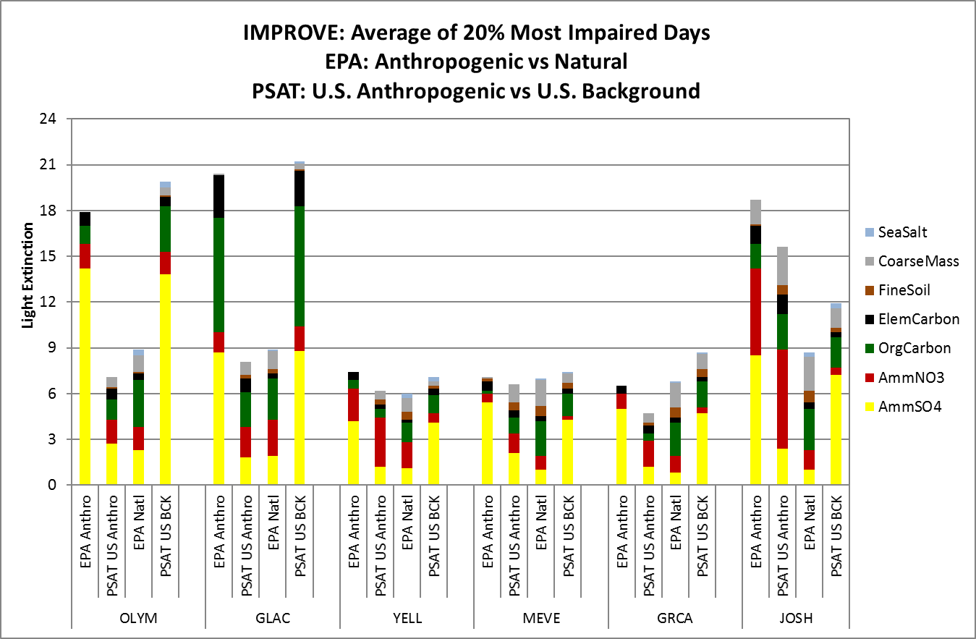
WRAP 2011 WAQS example of Source Apportionment
EPA split of natural and athropogenic contributions to IMPROVE monitoring data.
CAMx PSAT modeled aerosol extinction and contributions adjusted to IMPROVE measurements
Brewer et al 2018.

Slide 25
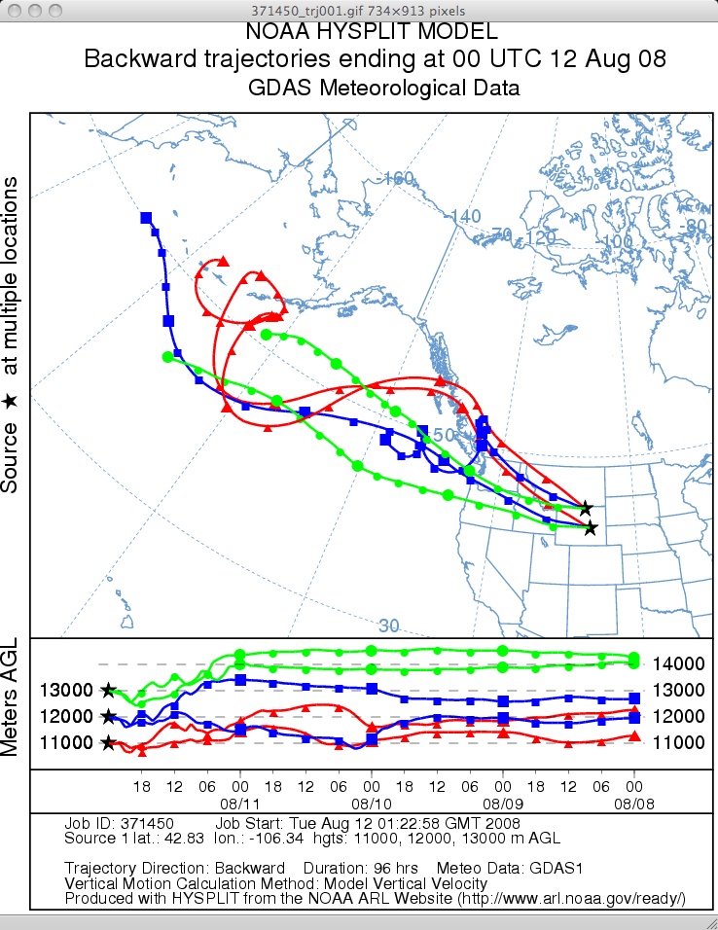
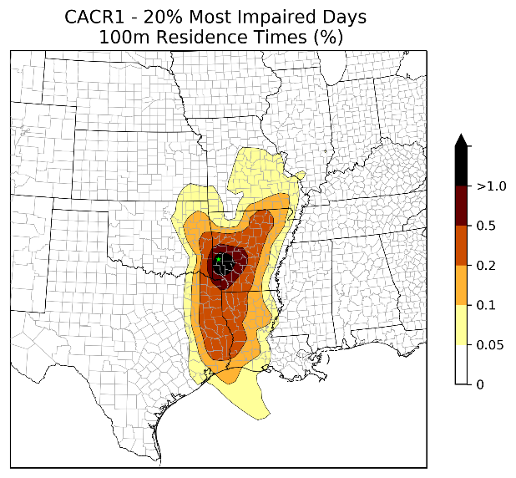
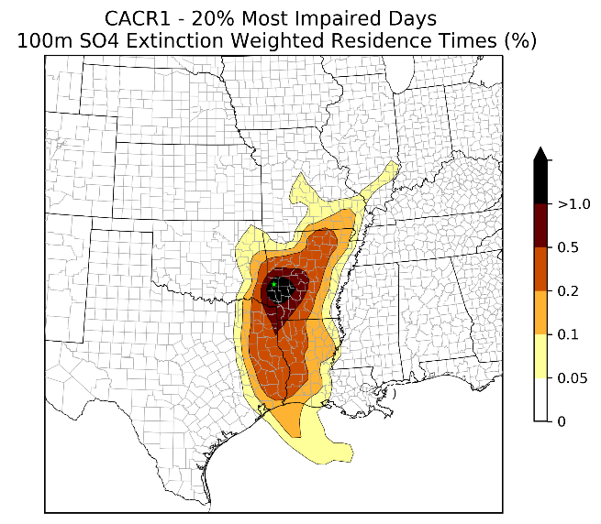
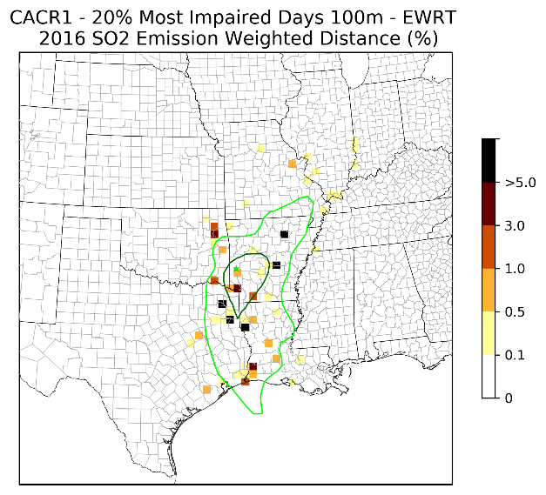
Weighted Emissions Potential (WEP)/ Area of Influence (AOI)
Identify potential source impact at Class I area
Prioritize sources for additional emissions reductions

Slide 26
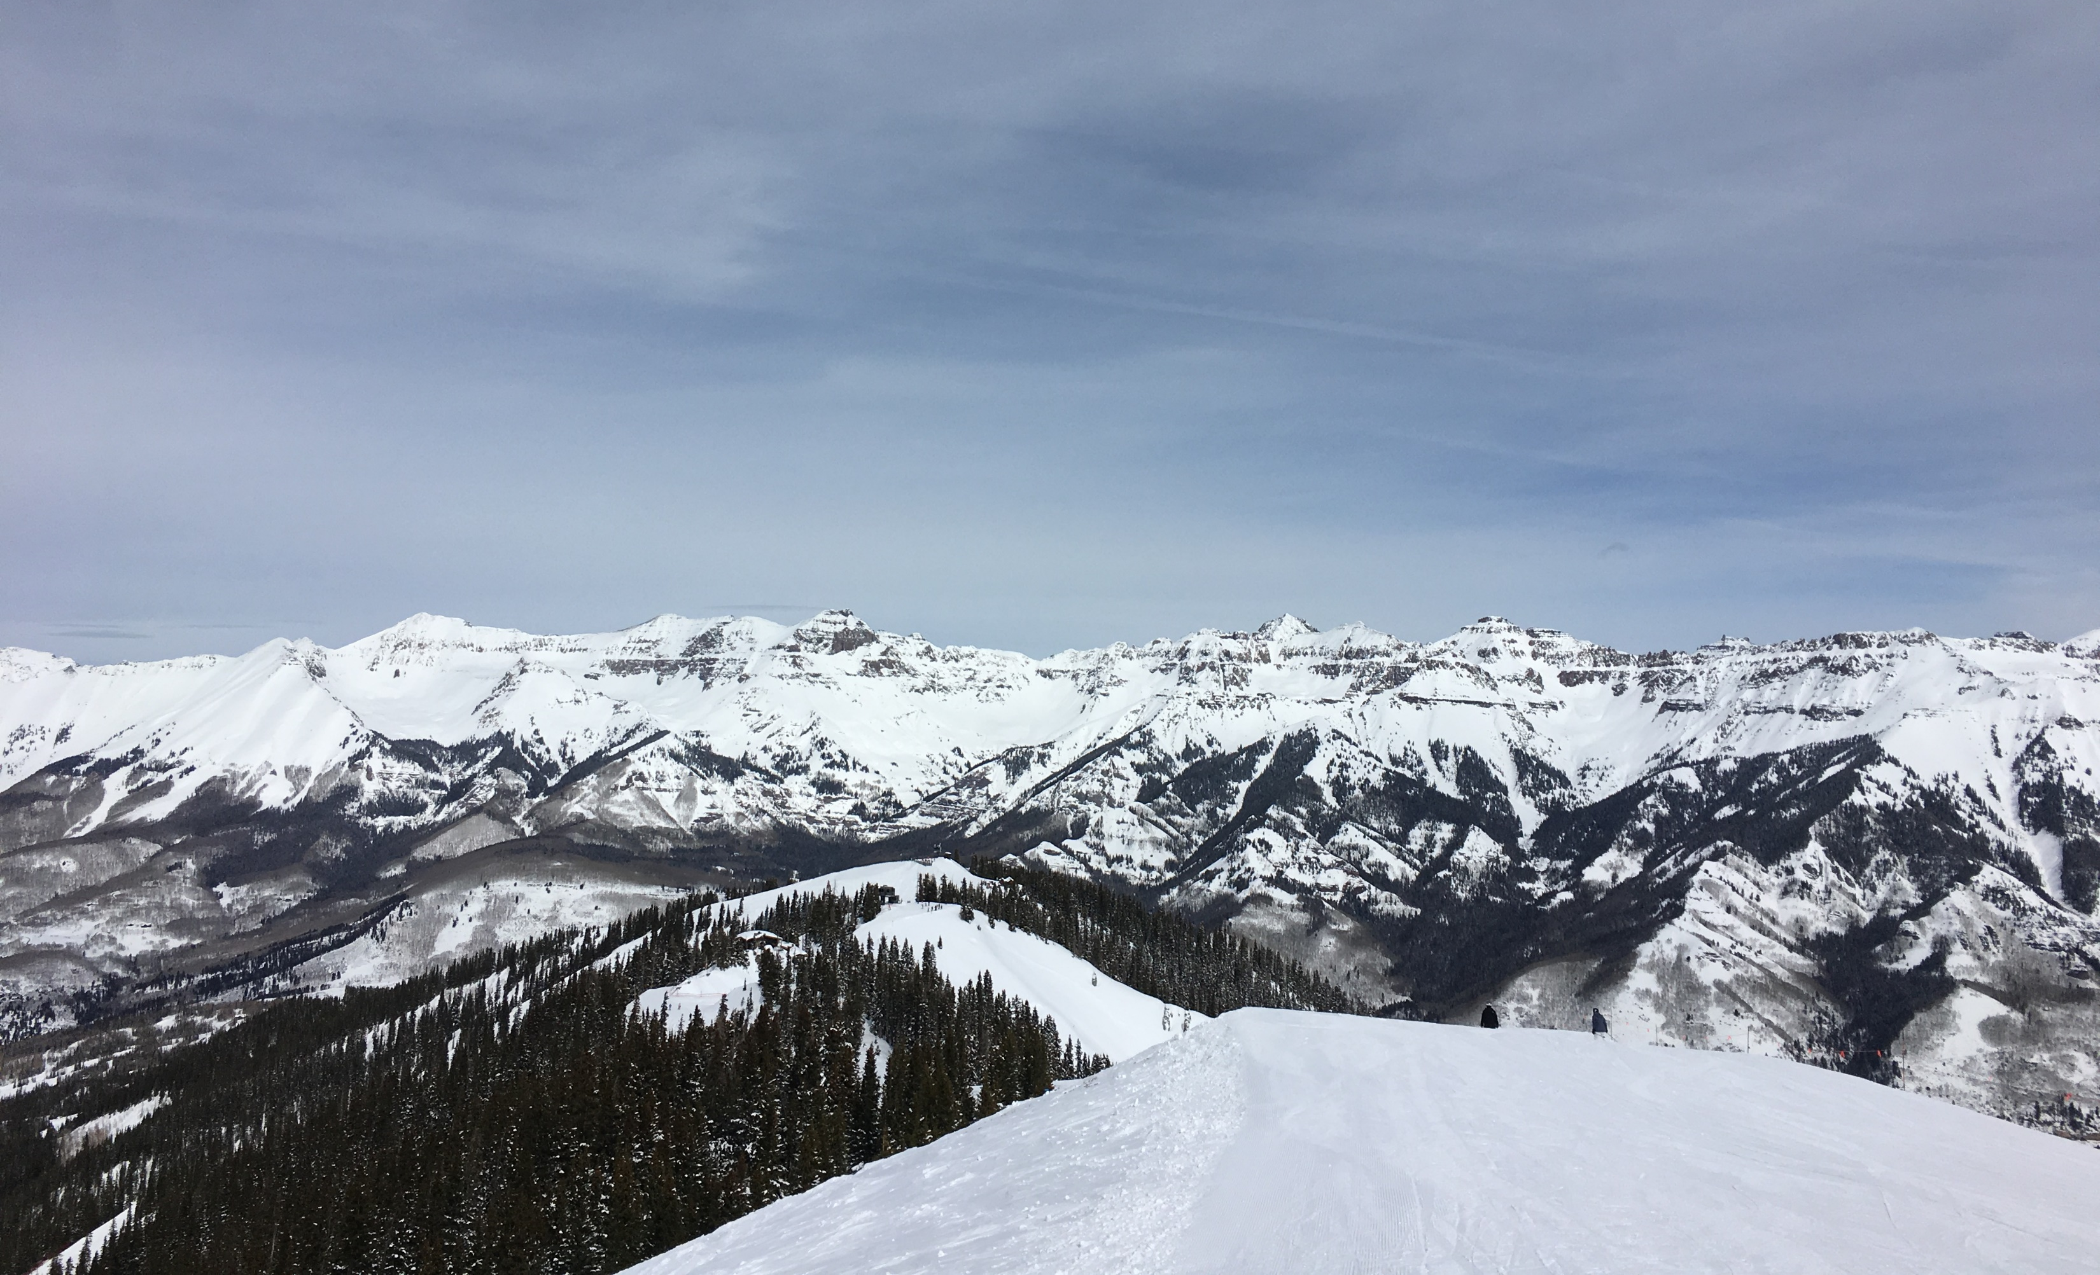
Happy Holidays!

